Slide 1
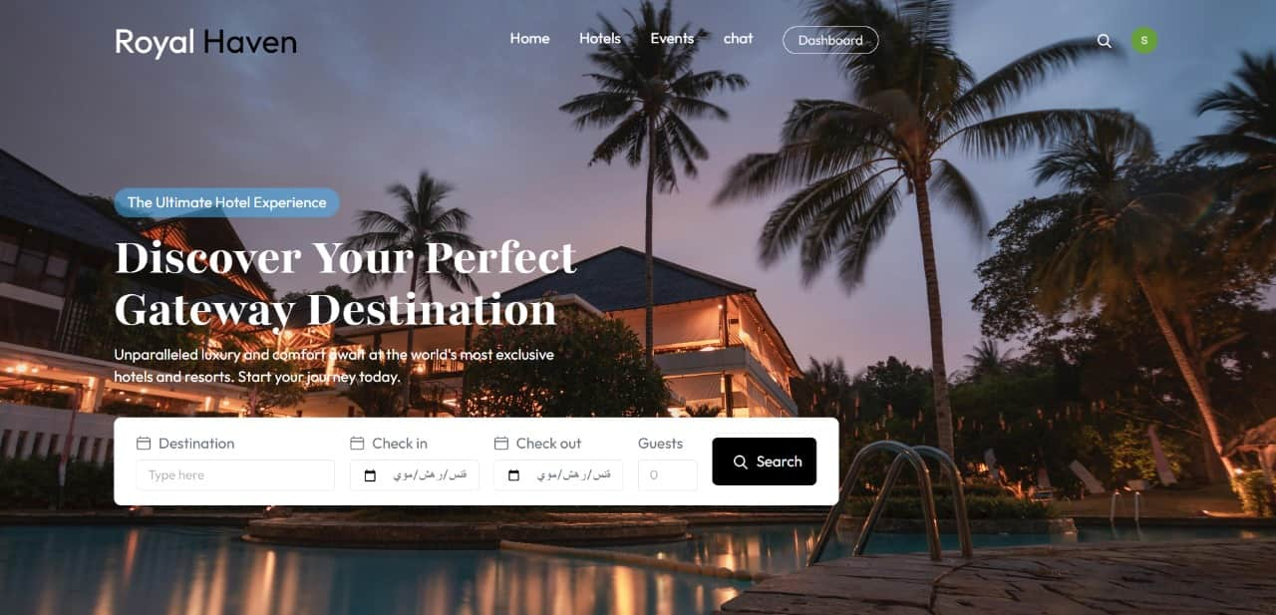

Slide 2







Our Team
.
Youmna Abdeltawab
Shahd Nady
Shahd Ahmad
Noran Mohamad
Supervisor :
Dr. Amira Idris Eng. Rehab Abu Al-Hassan
Mohamed Rady
Mohamed Omer
Emad Salib

Slide 3
Table of Content
Introduction
Problem definition
Releated Work
Conclusion
References
Objectives
Implementation Tools
Features
System life cycle
Prototype

Slide 4

Introduction
A web-based system for easy hotel booking and management.
Guests can reserve rooms and pay online, while administrators manage bookings, payments, and reports efficiently.​

Slide 5
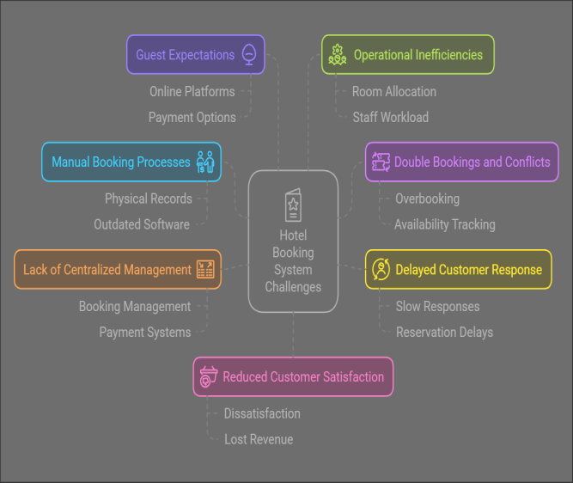
Problem definition

Slide 6

Objectives
Objectives
1-Simplify the Booking process
2-Centralized hotel Management
3-Increase operational efficiency
4-Enhance customer Experience e r
5-Ensure Data Security y a
6-Optimized Revenue Management
7- Reduce Administrative Workload

Slide 7
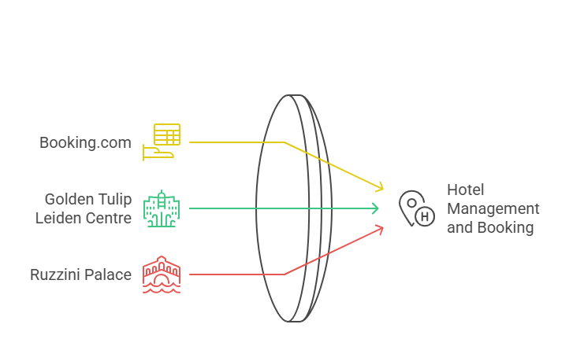
Related ​System:

Slide 8
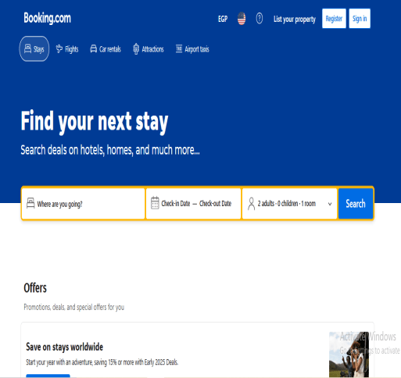
Booking.com
Booking.com is a global platform for online bookings, renowned for its ease of use and clear interface that enables users to customize their options effortlessly.
User Interface Simple and intuitive, allowing easy accommodation searches.
Homepage Features
Destination: Select travel location.
Check-in/check-out dates: Choose stay dates.
Number of guests: Customize results based on guest count.

Slide 9
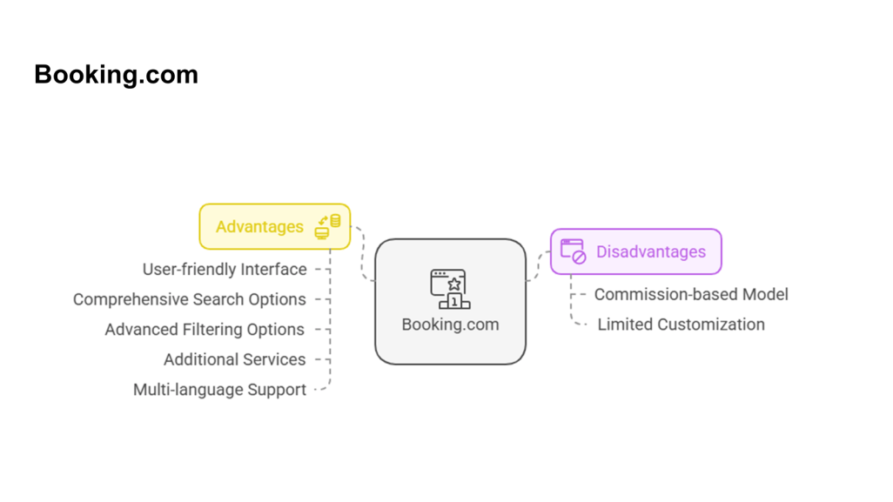
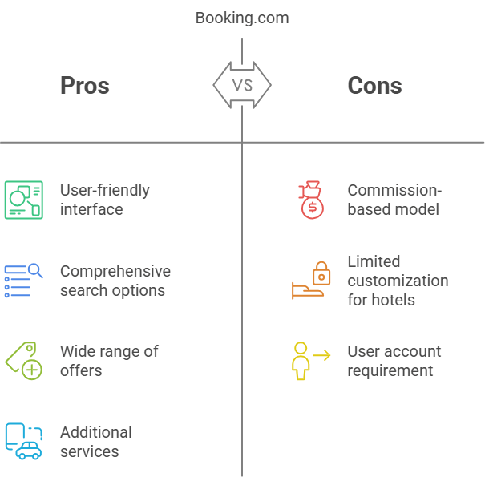
Booking.com

Slide 10
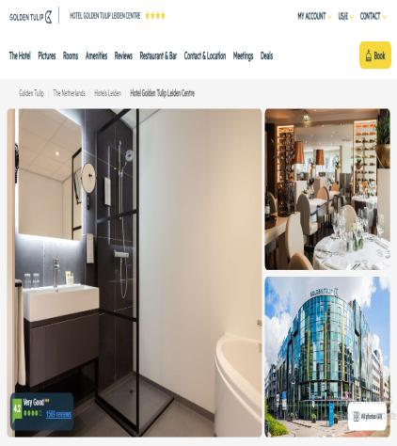
Golden Tulip Leiden Centre
Golden Tulip Leiden Centre offers a user-friendly platform with essential information for both business and leisure travelers.
Homepage Features
Room types: Information on available rooms.
Amenities & services: Hotel facilities details.
Booking: Direct online booking options.

Slide 11
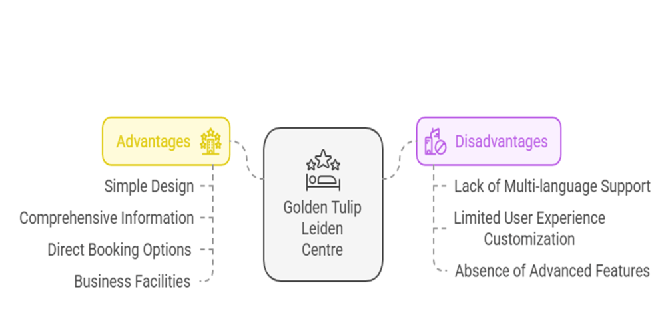
Golden Tulip Leiden Centre

Slide 12
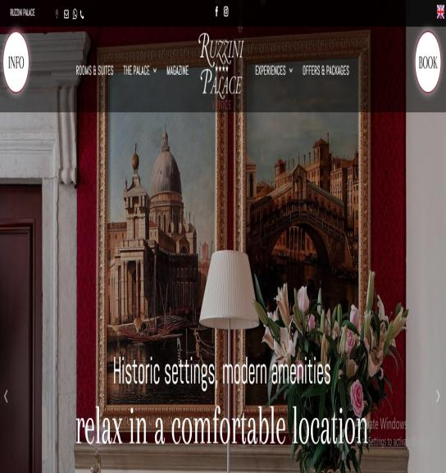
Ruzzini Palace
Ruzzini Palace is a luxurious hotel website with a sleek design that reflects its historic charm, offering essential features for a smooth user experience.
Homepage Features
Navigation bar: "Rooms & Suites," "Offers," and "Gallery."
Book Now: Direct booking button.
Contact & Location: Easy access to contact details and location.

Slide 13
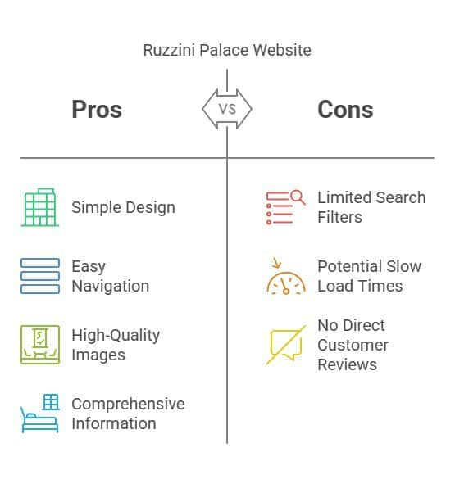
Ruzzini Palace
.

Slide 14
Key Features
Online Banking Platform
Customers ​Profile Management
Booking confirmation and Notification
Payment Integration
Real-time Room Availability
Room and Rate Management
Guest Check in/ Check out Management
Housekeeping and maintenance Management
Multi-user access and Role-Based Permissions

Slide 15
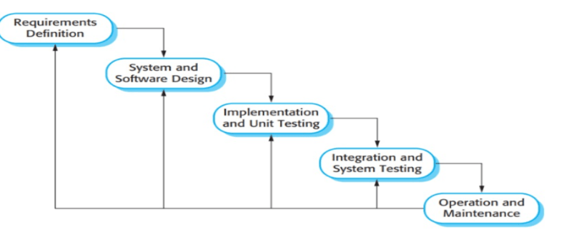
System Life Cycle Waterfall Model
.

Slide 16

System Requirements
Functional Requirements
Non Functional Requirements
​
User Authentication and Authorization
Room Management
Booking Management
Payment Processing
Guest Management
Employee Management
Audit Log
Report Generation
Notifications and Alerts
Search and Filter
Performance
Aailability
Scalability
Security
Usability
Reliability
Portability
Maintainability
Compliance
Localization

Slide 17
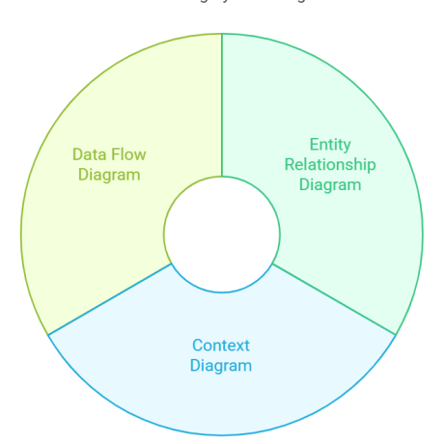
Diagrams
.

Slide 18
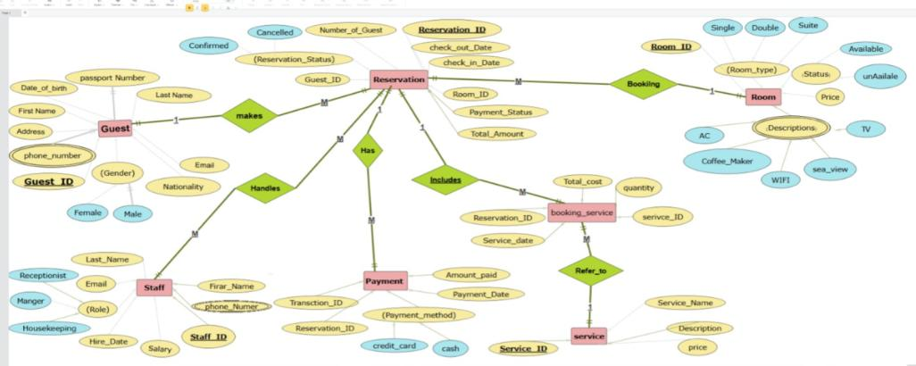
Entity Relationship Diagram(ERD)

Slide 19
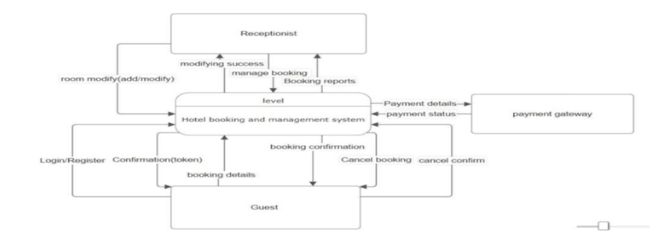
Context Diagram
.

Slide 20
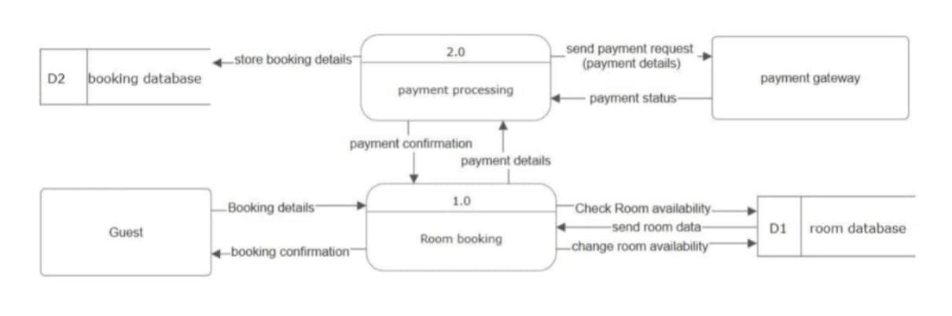
Data Flow Diagram booking Process level 1
.

Slide 21
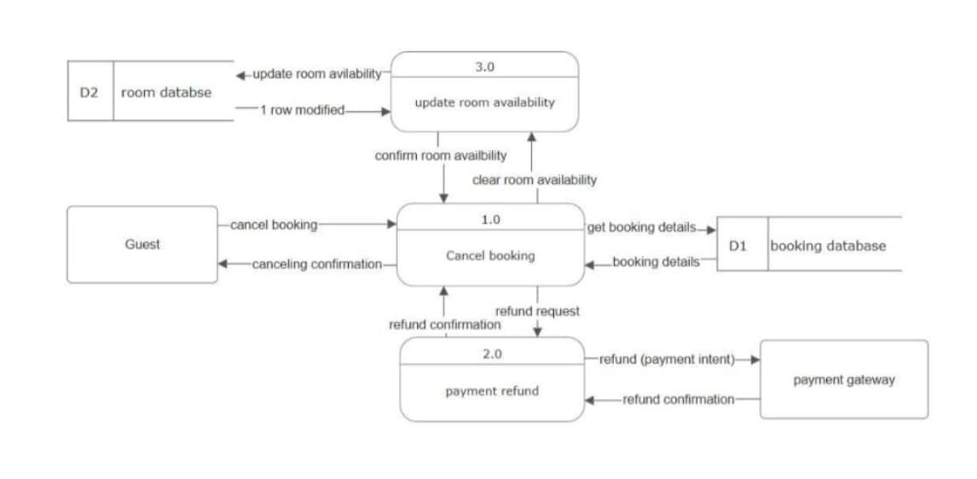
Data Flow Diagram canceling process level 1

Slide 22
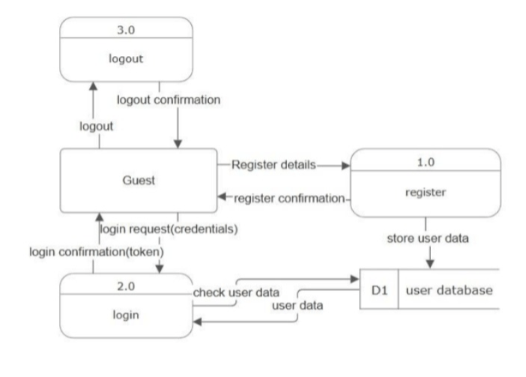
Authentications and View rooms Diagram

Slide 23


Slide 24
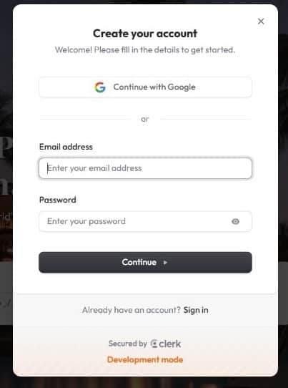
.
Registration page​
New users create
an account by providing
basic information
and setting a password

Slide 25
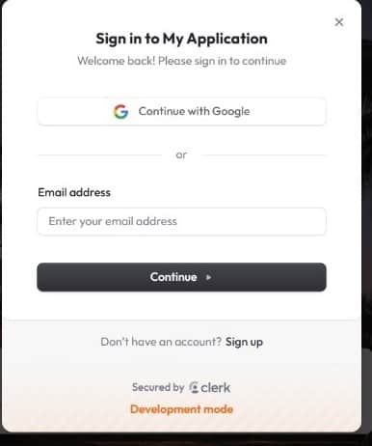
Log in Page
Users enter their credentials to access their accounts securely.​

Slide 27
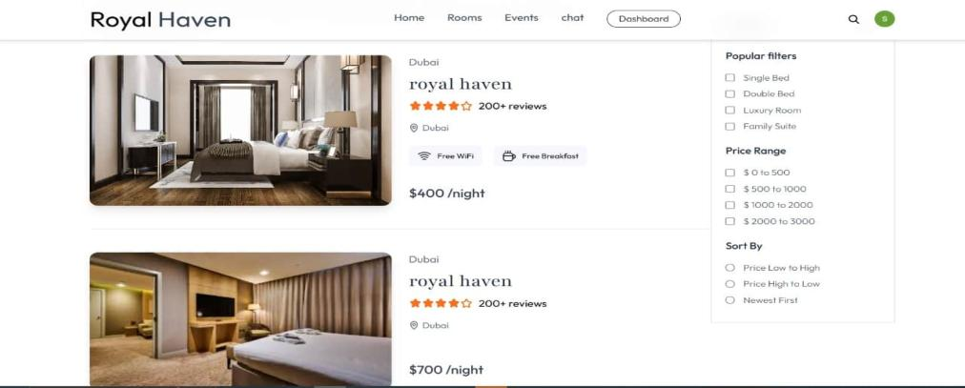
Rooms& Suites page

Slide 28
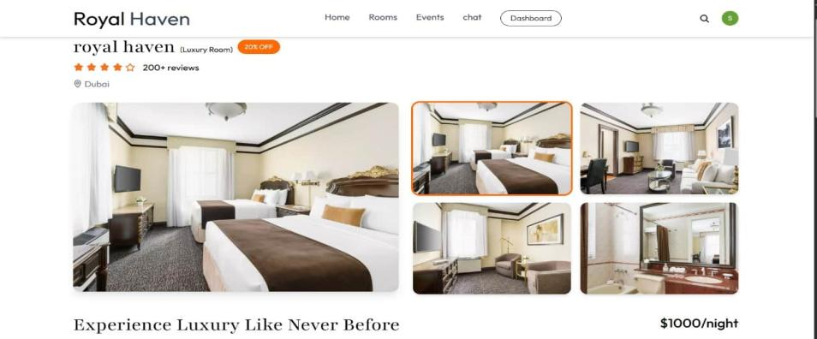
Rooms &Suites page

Slide 29
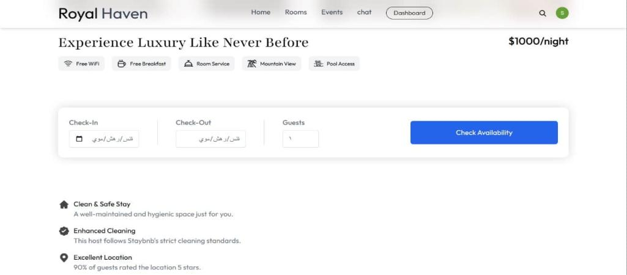
Room Details page

Slide 30
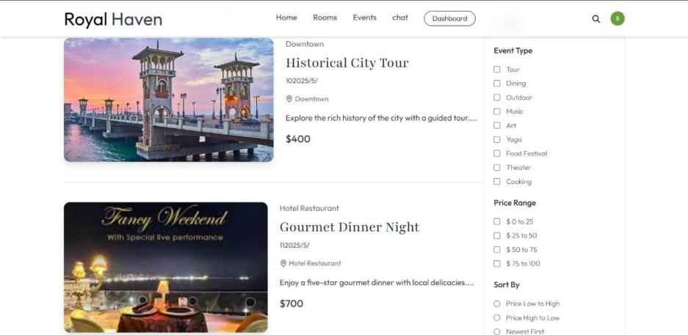
Events page

Slide 31
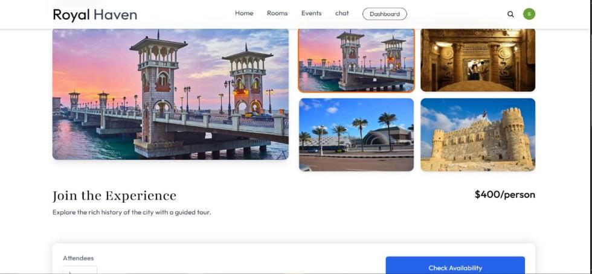
events page details

Slide 32
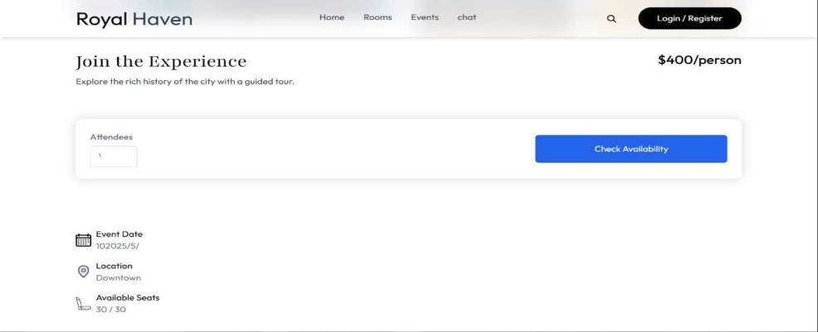
Events page Details

Slide 33
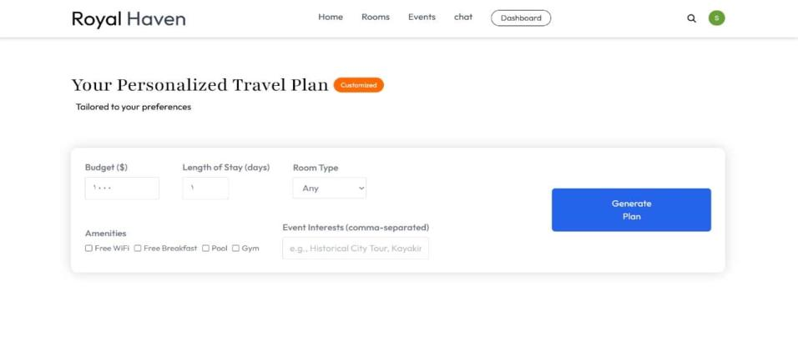
Recommendation plans

Slide 34
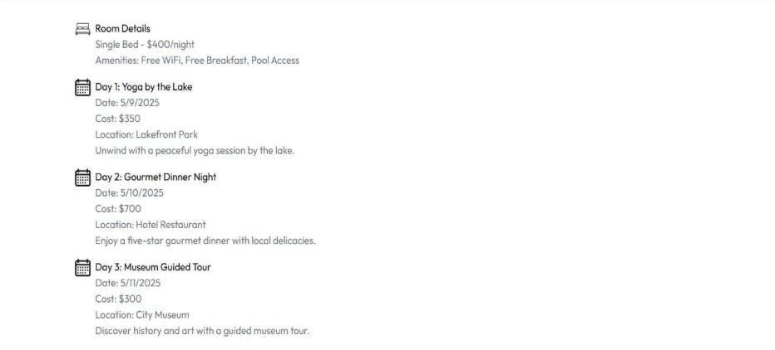
Recommendation plans

Slide 35
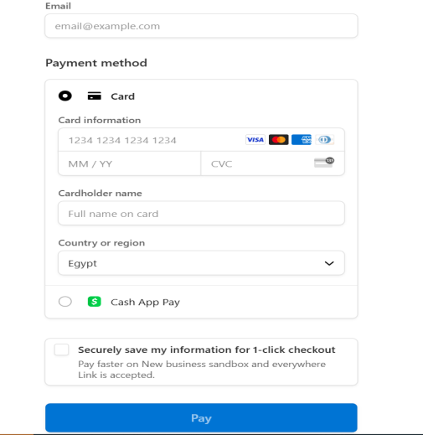
Payment Page
Guest selects a room and confirms the booking.
System redirects the guest to the secure payment page.
Guest chooses a payment method and enters payment details.
System sends the details to the Payment Gateway for validation.
Payment Gateway communicates with the bank for verification.

Slide 36


Slide 37
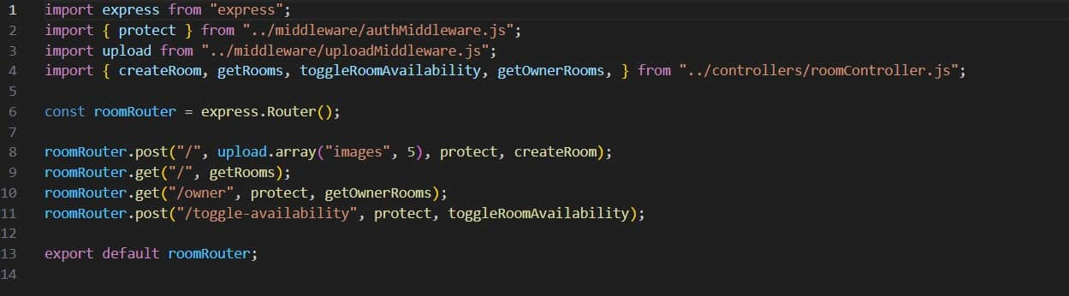
Rooms

Slide 38
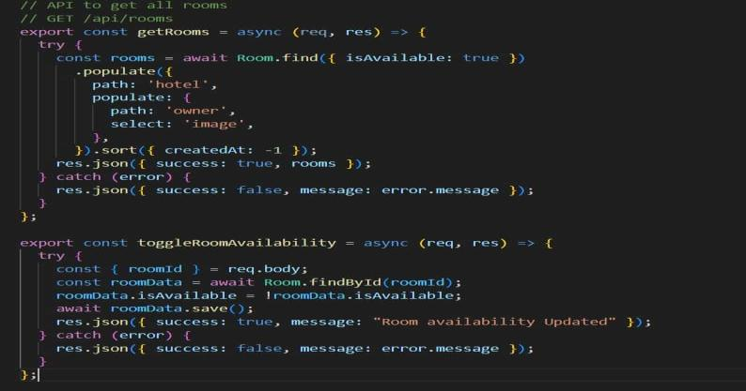
Rooms

Slide 39
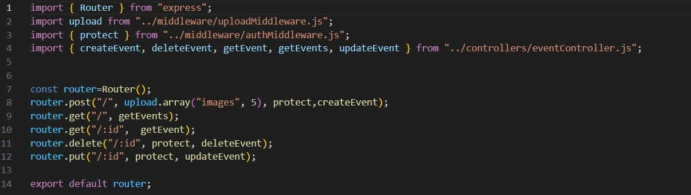
Events

Slide 40
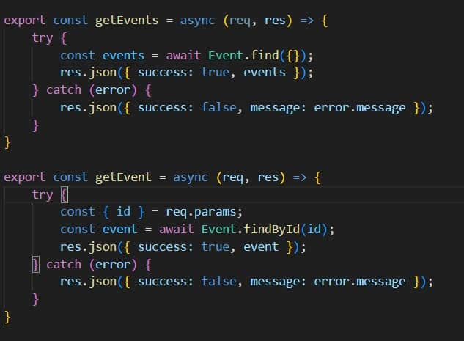
Events

Slide 41
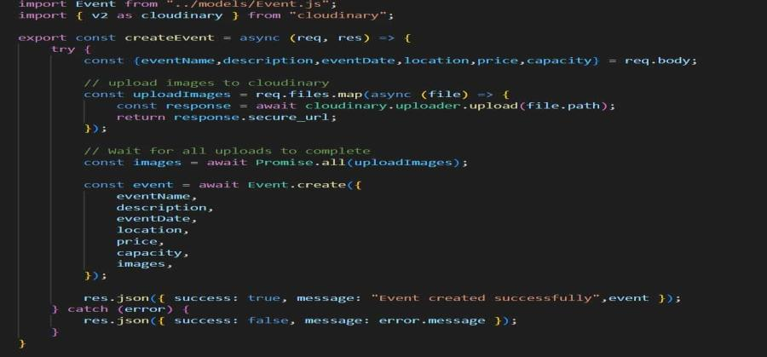
Events

Slide 42
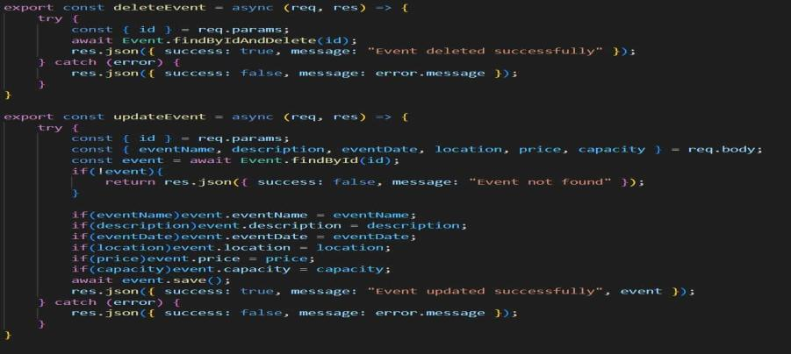
Events

Slide 43
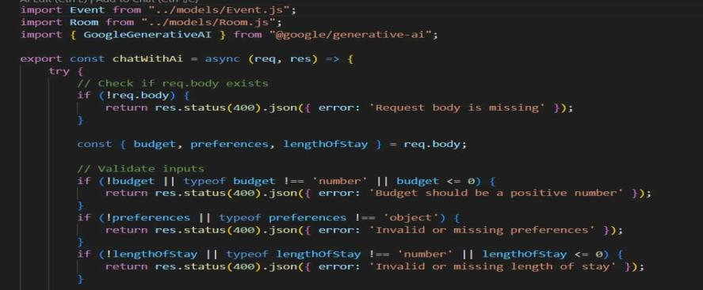
Recommendation plans

Slide 44
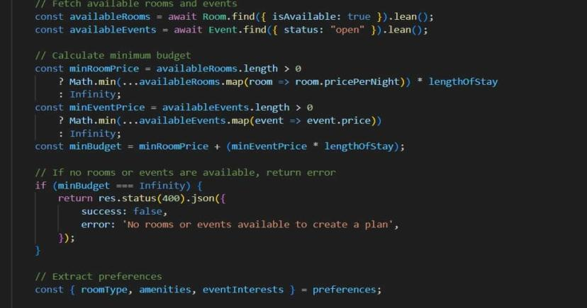
Recommendation plans

Slide 45
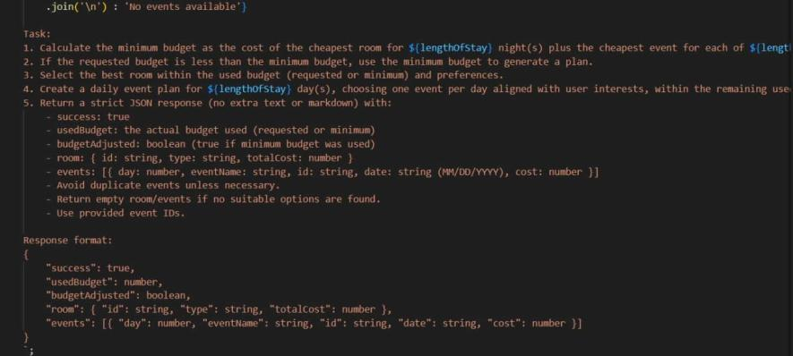
Recommendation plans

Slide 46
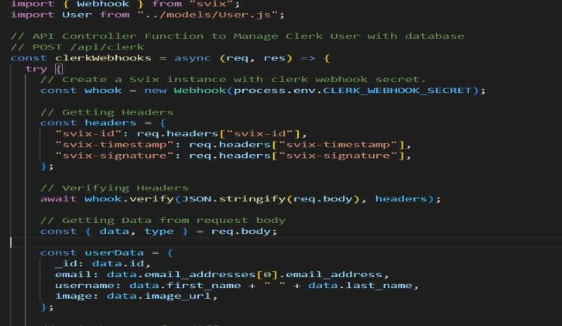
Authentication

Slide 47
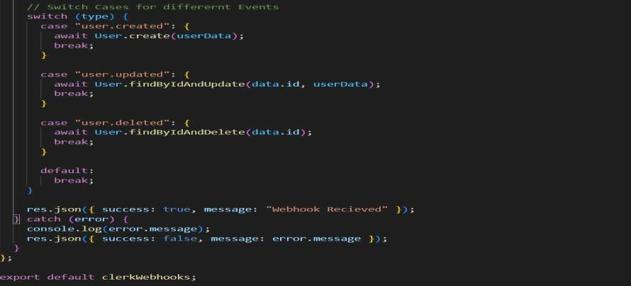
Authentication

Slide 48
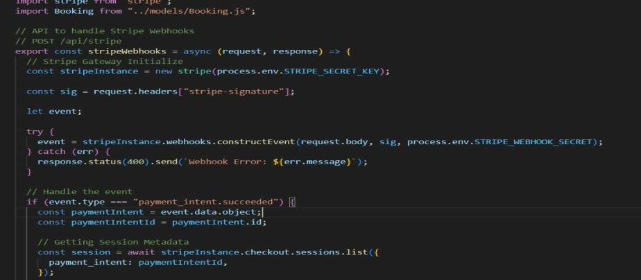
Payments

Slide 49
Environment Configuration
This file contains environment variables used to connect the system with external services such as:
MongoDB for database management and storage.
Cloudinary for image storage and management.
Clerk for user authentication and identity management.
Stripe for secure online payment processing.
SMTP (Brevo) for sending email notifications to users.
Gemini API for AI-based features or smart suggestion

Slide 50
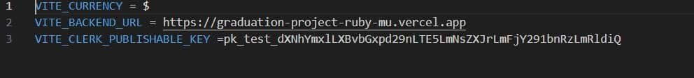
Environment Configuration(Frontend)

Slide 51
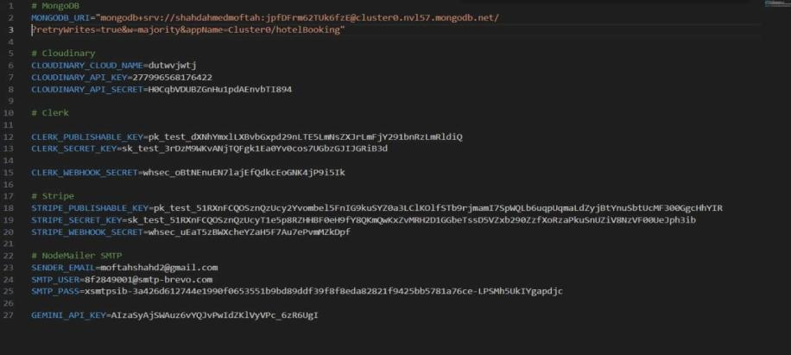
Environment Configuration(Backend

Slide 52

DEMO

Slide 53

conclusion
Improve operations: Reduce manual effort and increase efficiency.
User experience: Provide a smooth and easy interface for booking.
Security: Process data in secure and modern ways.
System flexibility: Ability to update and develop over time.

Slide 54








.
TOOLS

Slide 55
Reference
https://www.booking.com/index.ar.html?aid=2311236;label=ar-eg-booking-desktop-J0eEFVeEPF5nuQzuUnAyGQS652897951130:pl:ta:p1:p2:ac:ap:neg:fi:tikwd-334108349:lp1005382:li:dec:dm;ws=&gad_source=1&gclid=CjwKCAiAnpy9BhAkEiwA-P8N4imHSU9NuDl3iwjfz1I277WMpzDenQWZxHdIermPJRnocr7AXr2i4xoCEpMQAvD_BwE
https://leiden-centre.goldentulip.com/en-us/
https://www.ruzzinipalace.com/it?utm_source=google&utm_medium=cpc&utm_campaign=Brand%20Protection%20-%20IT&gad_source=1&gclid=CjwKCAiAnpy9BhAkEiwA-P8N4kykY_N4U6_eytBUEigdI_AhBORYzhgYw86gyKoc7sDGvH1KkJAhuhoCO9sQAvD_BwE

Slide 56

Thank You

